Slide 1

Learning Objective
Factorise algebraic expressions by grouping in pairs.
Enter quietly, please be ready with the following on your desk:
Whiteboard
Whiteboard marker
Exercise Book
Pencil, pen, ruler and red pen
Diary
Calculator
Device – charged or borrowed from Library before maths

Slide 2
Daily Review
Reminders:
Multiply everything in the 1st bracket by everything in the 2nd bracket$.$
Expand the binomial product: $(x+5)(x+8)$
$$x$$
$$8$$
$$(x+5)(x+8)$$
$$x$$
$$x^{2}$$
$$8x$$
$$=x^{2}+5x+8x+40$$
$$5$$
$$5x$$
$$40$$
$$=x^{2}+13x+40$$

Slide 3
Daily Review
Reminders:
Multiply everything in the 1st bracket by everything in the 2nd bracket$.$
Expand the binomial product: $(x+5)(x−3)$
$$x$$
$$−3$$
$$(x+5)(x−3)$$
$$x$$
$$x^{2}$$
$$−3x$$
$$=x^{2}+5x−3x−15$$
$$5$$
$$5x$$
$$−15$$
$$=x^{2}+2x−15$$

Slide 4
Skill Development/Guided Practice
CFU 1
Using FOIL, expand the following binomial products
F = First
O = Outer
I = Inner
L = Last
What does FOIL stand for?
(2x + 5)(3x – 6) =
(4a – 2)(a + 3) =
6x²
– 12x
+ 15x
– 30
= 6x² + 3x – 30
4a²
+ 12a
– 2a
– 6
= 4a² + 10a – 6

Slide 5
Concept Development
CFU 1
How do we find the highest common factor of two algebraic terms?
Find the highest common factor of 24x²yz² and 36xyz³.
What is the highest common factor between the numbers?
The factors of 24 are 1 2 3 4 6 8 12 24
The factors of 36 are 1 2 3 4 6 9 12 18 36
The HCF of the numbers is 12.
What is the highest common factor between the variables?
Both x, y and z² are common variables.
The HCF of the variables is xyz².
The highest common factor of
24x²yz² and 36xyz³ is 12xyz²

Slide 6
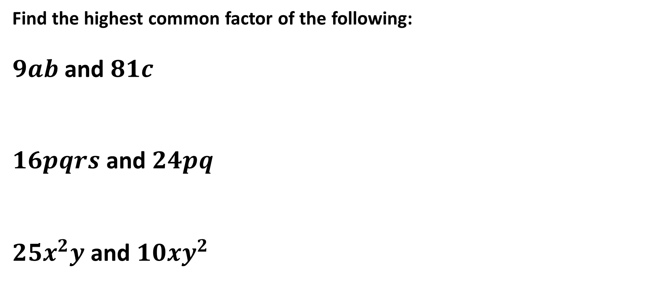
Guided Practice
HINT
What is the HCF of the numbers?
Find the highest common factor of the following:
$9ab$ and $81c$
$16pqrs$ and $24pq$
$25x^{2}y$ and $10{xy}^{2}$
HINT
Are there any common variables?
The highest common factor of $9ab$ and $81c$is $9$.
The highest common factor of $16pqrs$ and $24pq$is $8pq$.
The highest common factor of $25x^{2}y$ and $10{xy}^{2}$is $5xy$.

Slide 7
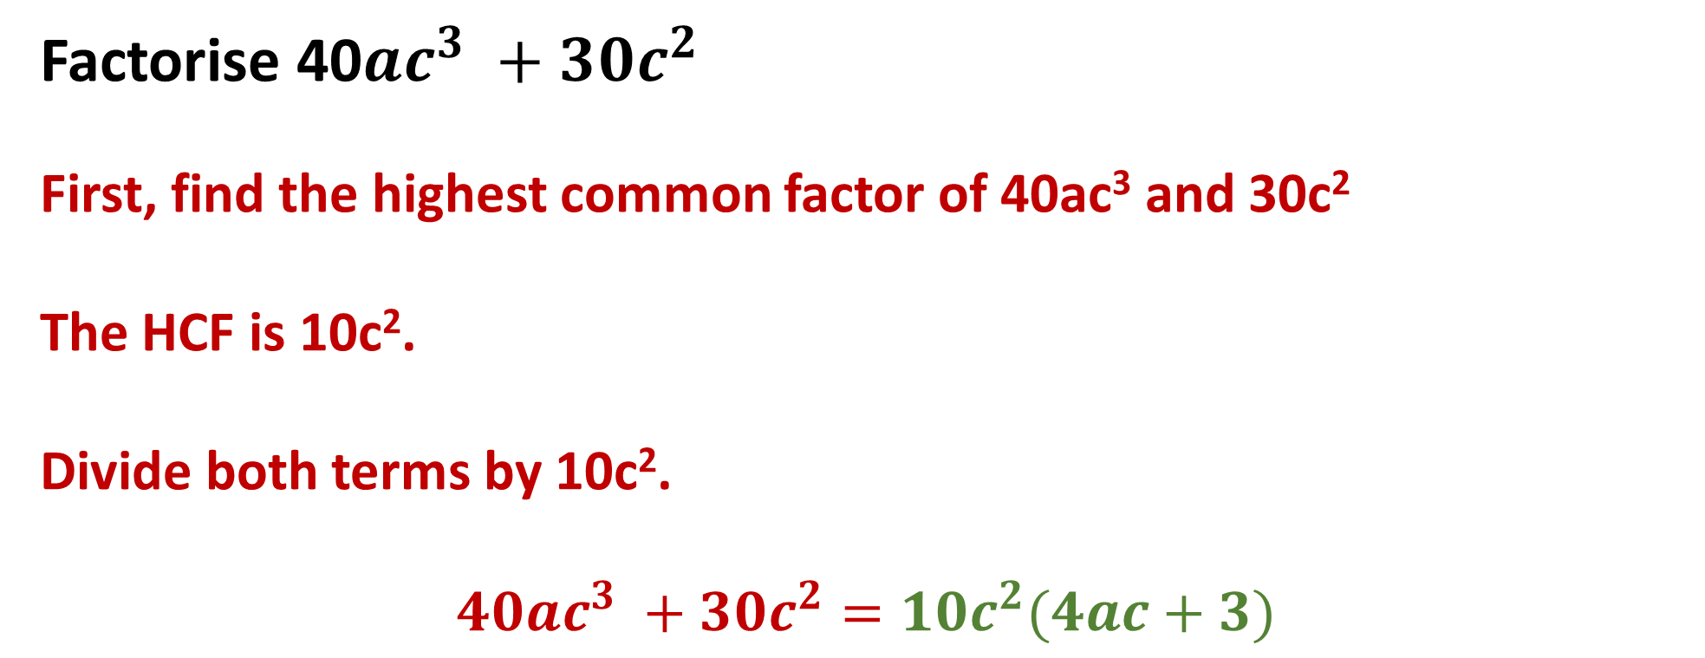
Concept Development
Factorise 40$ac^{3} +30c^{2}$
First, find the highest common factor of 40ac³ and 30c²
The HCF is 10c².
Divide both terms by 10c².
$$40ac^{3} +30c^{2}=10c^{2}(4ac+3)$$
CFU 1
What is factorising?
CFU 1
How did I factorise 120abc² + 20c²?

Slide 8
CFU 1
What will we learn today?
Today I will:
Factorise using grouping in pairs
CFU 2
What will we learn today?
CFU 3
What will we learn today?
CFU 4
How will you know that you are successful?
I will be able to:
Use the grouping in pairs method to factorise an algebraic expression.
CFU 5
How will you know that you are successful?

Slide 9
Concept Development
CFU 1
What was the common factor between k(m + 3) and 5(m + 3)?
Factorise the following expression:
k(m + 3) + 5(m + 3)
Notice that there is something common to both terms in this expression: (m + 3)
Divide both algebraic terms by (m + 3)
k(m + 3) + 5(m + 3) = (m + 3)(k + 5)
CFU 2
What were the steps in factorising k(m + 3) + 5(m + 3)?

Slide 10
Concept Development
For expressions with four terms, you can sometimes factorise by grouping in pairs. To factorise by grouping in pairs:
Check that the expression has four terms
Group the terms into pairs, with a common factor in each pair
Take out the common factor from each pair of terms, then write the expression as a binomial product.
CFU 1
What are the steps in factorising by grouping in pairs?

Slide 11

Concept Development
CFU 1
What is step one in factorising using grouping in pairs?
Factorise $x\left(k+1\right)+4(k+1)$
CFU 2
What is step two in factorising using grouping in pairs?
Step 1: the highest common factor of both terms is (k+1)
Step 2: take the highest common factor out of each term which leaves $\left(k+1\right) (x+4$)

Slide 12

Concept Development
CFU 1
What is step one in factorising using grouping in pairs?
Factorise $a(x−4)$+ $6(x −4)$
CFU 2
Step 1: the highest common factor of both terms is (x – 4)
What is step two in factorising using grouping in pairs?
Step 2: take the highest common factor out of each term which leaves $\left(x−4\right)(a+6)$

Slide 13

Skill Development
CFU 1
What is step one in factorising using grouping in pairs?
Factorise $d(c+5)$+ $(c+5)$
CFU 2
Step 1: the highest common factor of both terms is (c + 5)
What is step two in factorising using grouping in pairs?
Step 2: take the highest common factor out of each term which leaves $\left(c+5\right)(d+1)$

Slide 14

Concept Development
CFU 1
What is step one in factorising using grouping in pairs?
Factorise $ab+7b+2a+14$
Step 1: group into pairs: ab$+7b +2a+14$
CFU 2
What is step two in factorising using grouping in pairs?
Step 2: Factorise each pair: b(a + 7) + 2(a + 7)
CFU 3
What is step three in factorising using grouping in pairs?
Step 3: The highest common factor of both terms is: (a + 7)
CFU 4
Step 4: Take out the highest common factor from each
pair which leaves: (a + 7) (b + 2)
What is step four in factorising using grouping in pairs?

Slide 15

Skill Development
CFU 1
What is step one in factorising using grouping in pairs?
Factorise $gh−fh−dg+df$
Step 1: group into pairs: $gh−fh−dg+df$
CFU 2
What is step two in factorising using grouping in pairs?
Step 2: Factorise each pair: h(g - f) - d(g - f)
CFU 3
What is step three in factorising using grouping in pairs?
Step 3: The highest common factor of both terms is: (g - f)
CFU 4
Step 4: Take out the highest common factor from each
pair which leaves: (h - d) (g - f)
What is step four in factorising using grouping in pairs?

Slide 16

Skill Development
CFU 1
What is step one in factorising using grouping in pairs?
Factorise $6ab−4b−15a+10$
Step 1: group into pairs: $6ab−4b−15a+10$
CFU 2
What is step two in factorising using grouping in pairs?
Step 2: Factorise each pair: 2b(3a - 2) - 5(3a - 2)
CFU 3
What is step three in factorising using grouping in pairs?
Step 3: The highest common factor of both terms is: (3a-2)
CFU 4
Step 4: Take out the highest common factor from each
pair which leaves: (3a-2) (2b-5)
What is step four in factorising using grouping in pairs?

Slide 17
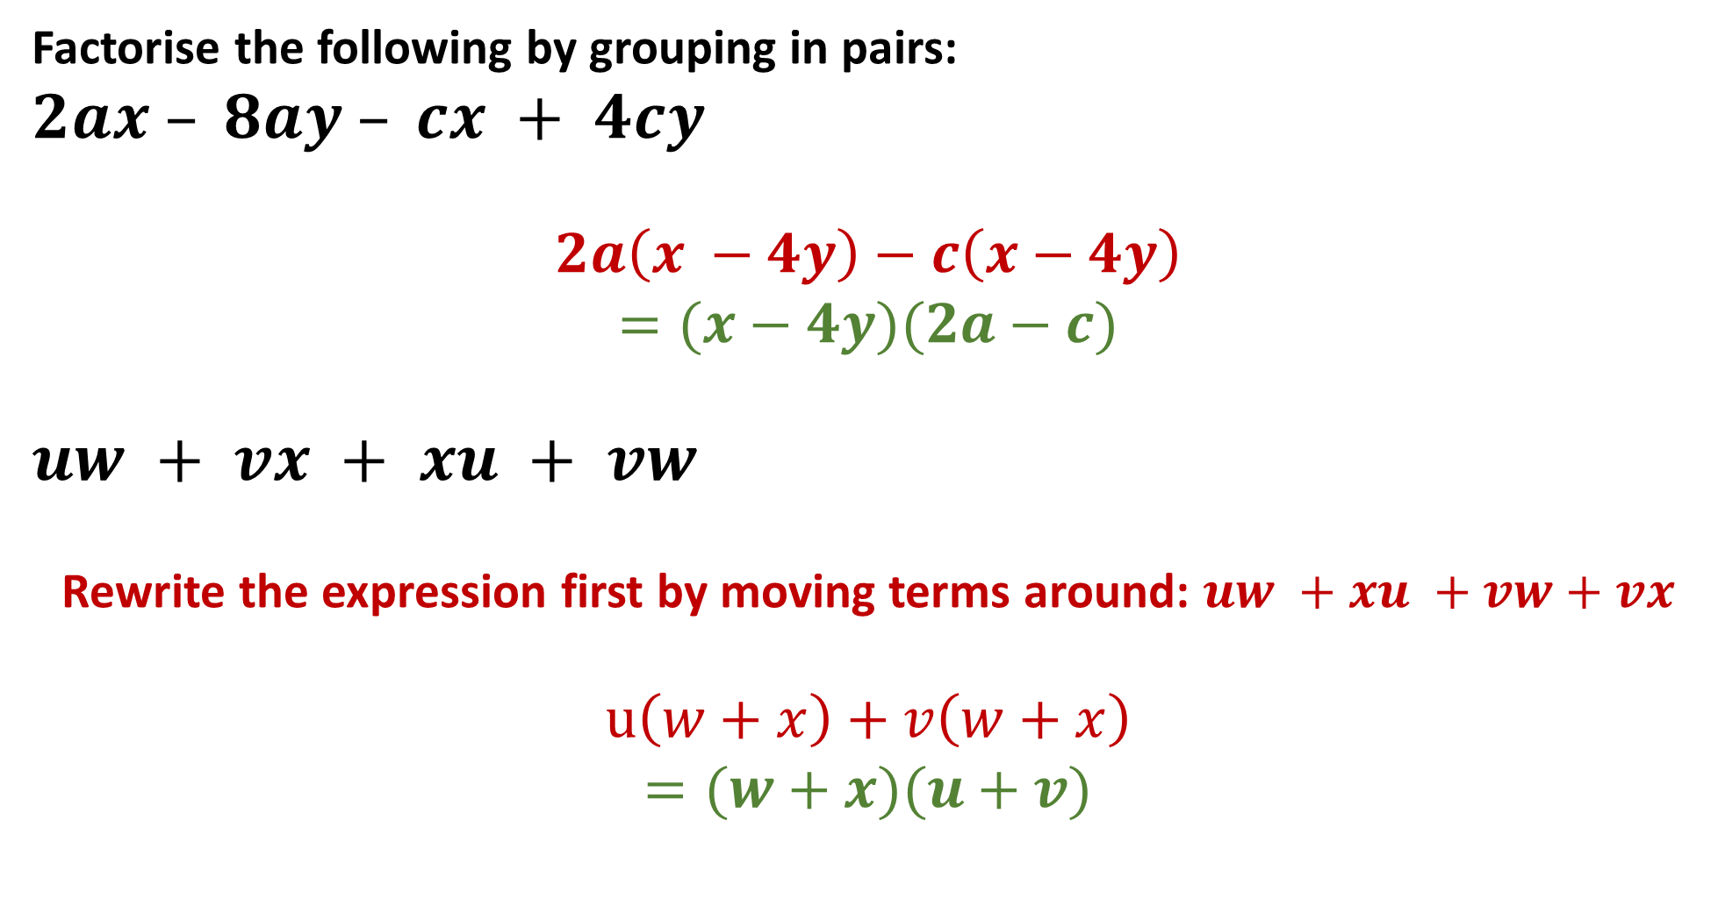
Guided Practice
Factorise the following by grouping in pairs:
$$2ax – 8ay – cx + 4cy$$
$$2a\left(x −4y\right)−c\left(x−4y\right)$$
$$=(x−4y)(2a−c)$$
$$uw + vx + xu + vw$$
Rewrite the expression first by moving terms around: $uw +xu +vw+vx$
$$u\left(w+x\right)+v\left(w+x\right)$$
$$=(w+x)(u+v)$$

Slide 18
Independent Practice
Pearson 10 Mathematics
Exercise 3.5: Factorising using Grouping in Pairs
Questions 1
Mathspace Activity

